Slide 1
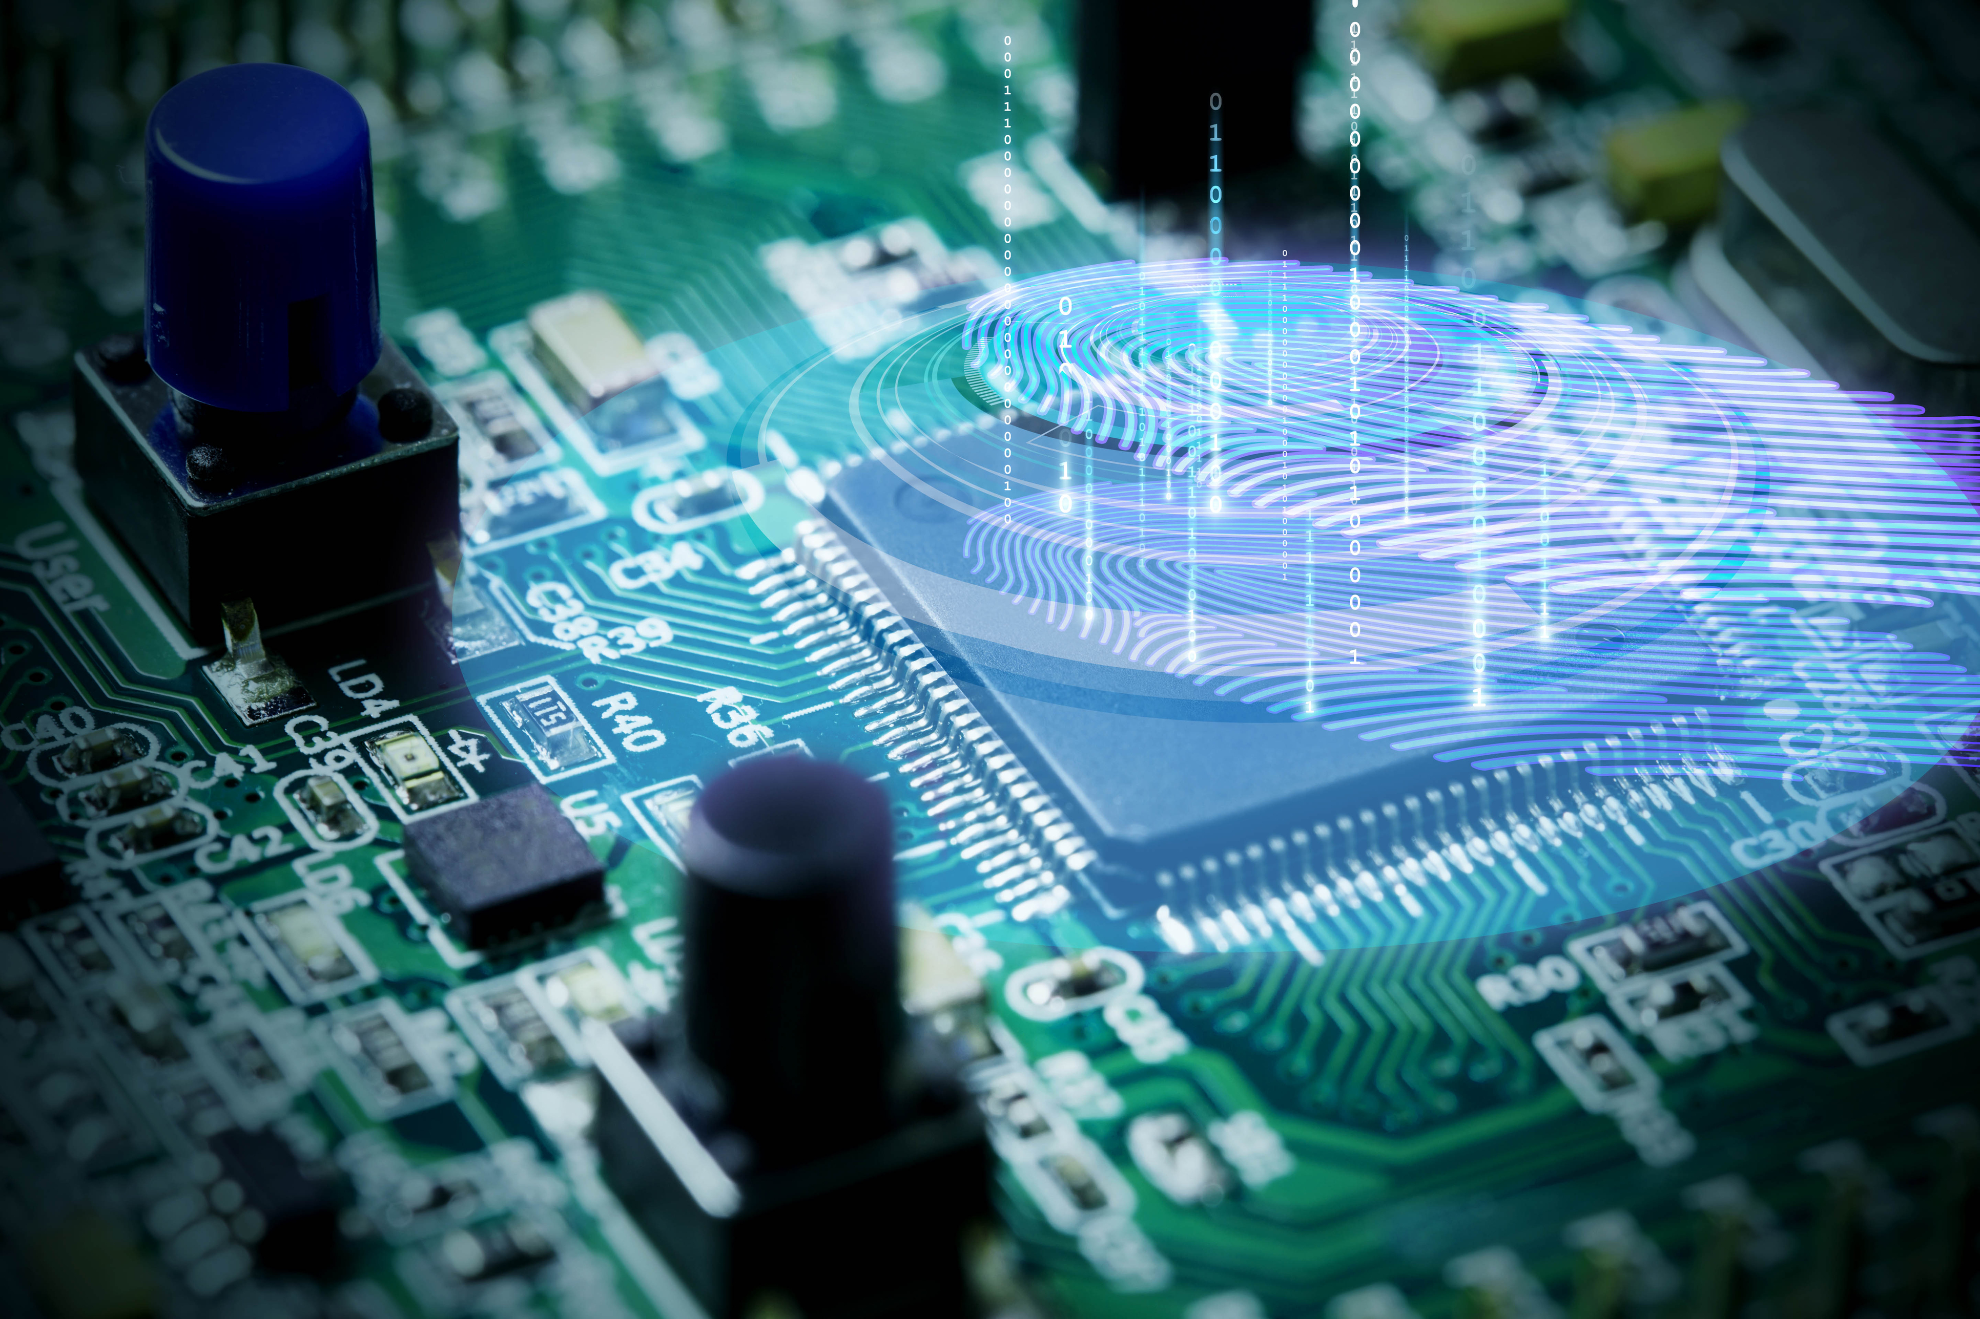

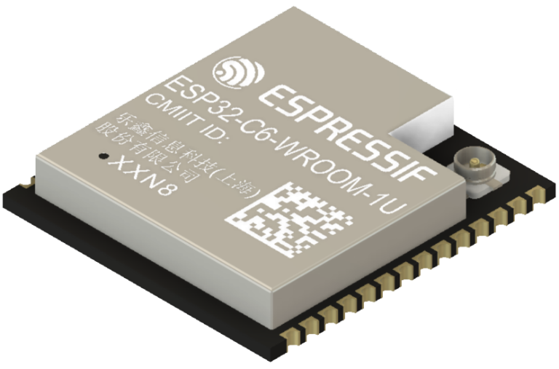

Table of Contents
30-Day FreeRTOS Course for ESP32 Using ESP-IDF
(Day 28)
“Real-Time Performance Optimizations”

Slide 2
30-Day FreeRTOS Course for ESP32 Using ESP-IDF
Table of Contents
(Day 28)
“Real-Time Performance Optimizations”

Slide 3
Overview
Table of Contents
Overview
Why Performance Optimization Matters
Common Performance Bottlenecks
Optimization Techniques
Profiling and Measurement
Example – Optimizing Task Performance
Best Practices
Summary
Challenge for Today

Slide 4
Overview

Slide 5
Why Performance Optimization Matters
Overview
On Day 28, you’ll learn:
Why performance optimization matters in real-time systems
Key sources of performance issues in FreeRTOS applications
Techniques for reducing task latency and jitter
How to optimize task priorities, context switches, and synchronization
Profiling tools and methods for measuring performance in ESP32
A practical example of performance tuning with tasks and queues
Best practices for building efficient and predictable real-time systems
By the end of this lesson, you’ll know how to identify and remove bottlenecks in FreeRTOS-based ESP32 applications.

Slide 6
Why Performance Optimization Matters

Slide 7
Common Performance Bottlenecks
Why Performance Optimization Matters
Embedded systems must often meet strict timing deadlines. Poorly tuned FreeRTOS applications can lead to:
Missed deadlines → unreliable sensor/actuator responses.
Task starvation → lower-priority tasks never execute.
High CPU load → excessive power consumption.
Jitter → unpredictable task execution times.
📌 Optimizing FreeRTOS ensures predictable, low-latency, real-time behavior.

Slide 8
Common Performance Bottlenecks

Slide 9
Optimization Techniques
Common Performance Bottlenecks
Too many context switches: switching tasks too often wastes CPU cycles.
Overuse of blocking calls: excessive waits can stall tasks unnecessarily.
Improper priorities: high-priority tasks may starve lower ones.
Large or slow queues: big messages or frequent sends increase latency.
Excessive logging/printf: UART I/O blocks CPU if not buffered.

Slide 10
Optimization Techniques

Slide 11
Optimization Techniques
Tune Task Priorities
Assign higher priorities only to critical tasks.
Avoid giving too many tasks the same high priority.
Reduce Context Switching
Increase task delay intervals when possible (vTaskDelayUntil() for periodic tasks).
Avoid splitting work across too many short-lived tasks.
Efficient Synchronization
Use task notifications instead of semaphores/queues for simple one-to-one signaling (faster, lighter).
Use mutexes only when necessary; avoid long critical sections.
Optimize Queue Usage
Use small, fixed-size messages (e.g., integers instead of structs).
If only signaling is needed, replace with binary semaphores or task notifications.
Leverage Hardware Features
Use ESP-IDF esp_timer for sub-millisecond timers instead of high-frequency tasks.
Offload repetitive jobs to peripherals (DMA, UART FIFO, I²C hardware).

Slide 12
Tune Task Priorities
Assign higher priorities only to critical tasks.
Avoid giving too many tasks the same high priority.
Reduce Context Switching
Increase task delay intervals when possible (vTaskDelayUntil() for periodic tasks).
Avoid splitting work across too many short-lived tasks.
Efficient Synchronization
Use task notifications instead of semaphores/queues for simple one-to-one signaling (faster, lighter).
Use mutexes only when necessary; avoid long critical sections.
Optimize Queue Usage
Use small, fixed-size messages (e.g., integers instead of structs).
If only signaling is needed, replace with binary semaphores or task notifications.
Leverage Hardware Features
Use ESP-IDF esp_timer for sub-millisecond timers instead of high-frequency tasks.
Offload repetitive jobs to peripherals (DMA, UART FIFO, I²C hardware).
Optimization Techniques

Slide 13
Tune Task Priorities
Assign higher priorities only to critical tasks.
Avoid giving too many tasks the same high priority.
Reduce Context Switching
Increase task delay intervals when possible (vTaskDelayUntil() for periodic tasks).
Avoid splitting work across too many short-lived tasks.
Efficient Synchronization
Use task notifications instead of semaphores/queues for simple one-to-one signaling (faster, lighter).
Use mutexes only when necessary; avoid long critical sections.
Optimize Queue Usage
Use small, fixed-size messages (e.g., integers instead of structs).
If only signaling is needed, replace with binary semaphores or task notifications.
Leverage Hardware Features
Use ESP-IDF esp_timer for sub-millisecond timers instead of high-frequency tasks.
Offload repetitive jobs to peripherals (DMA, UART FIFO, I²C hardware).
Profiling and Measurement
Optimization Techniques

Slide 14
Profiling and Measurement

Slide 15
Example – Optimizing Task Performance
Profiling and Measurement
ESP-IDF + FreeRTOS provide built-in tools:
vTaskGetRunTimeStats() → CPU usage by task.
uxTaskGetSystemState() → snapshot of tasks.
xPortGetMinimumEverFreeHeapSize() → memory usage trends.
uxTaskGetStackHighWaterMark() → stack optimization.
External tools:
Segger SystemView → real-time tracing of tasks and interrupts.
Tracealyzer → advanced visualization of scheduling and IPC.

Slide 16
Example – Optimizing Task Performance

Slide 17
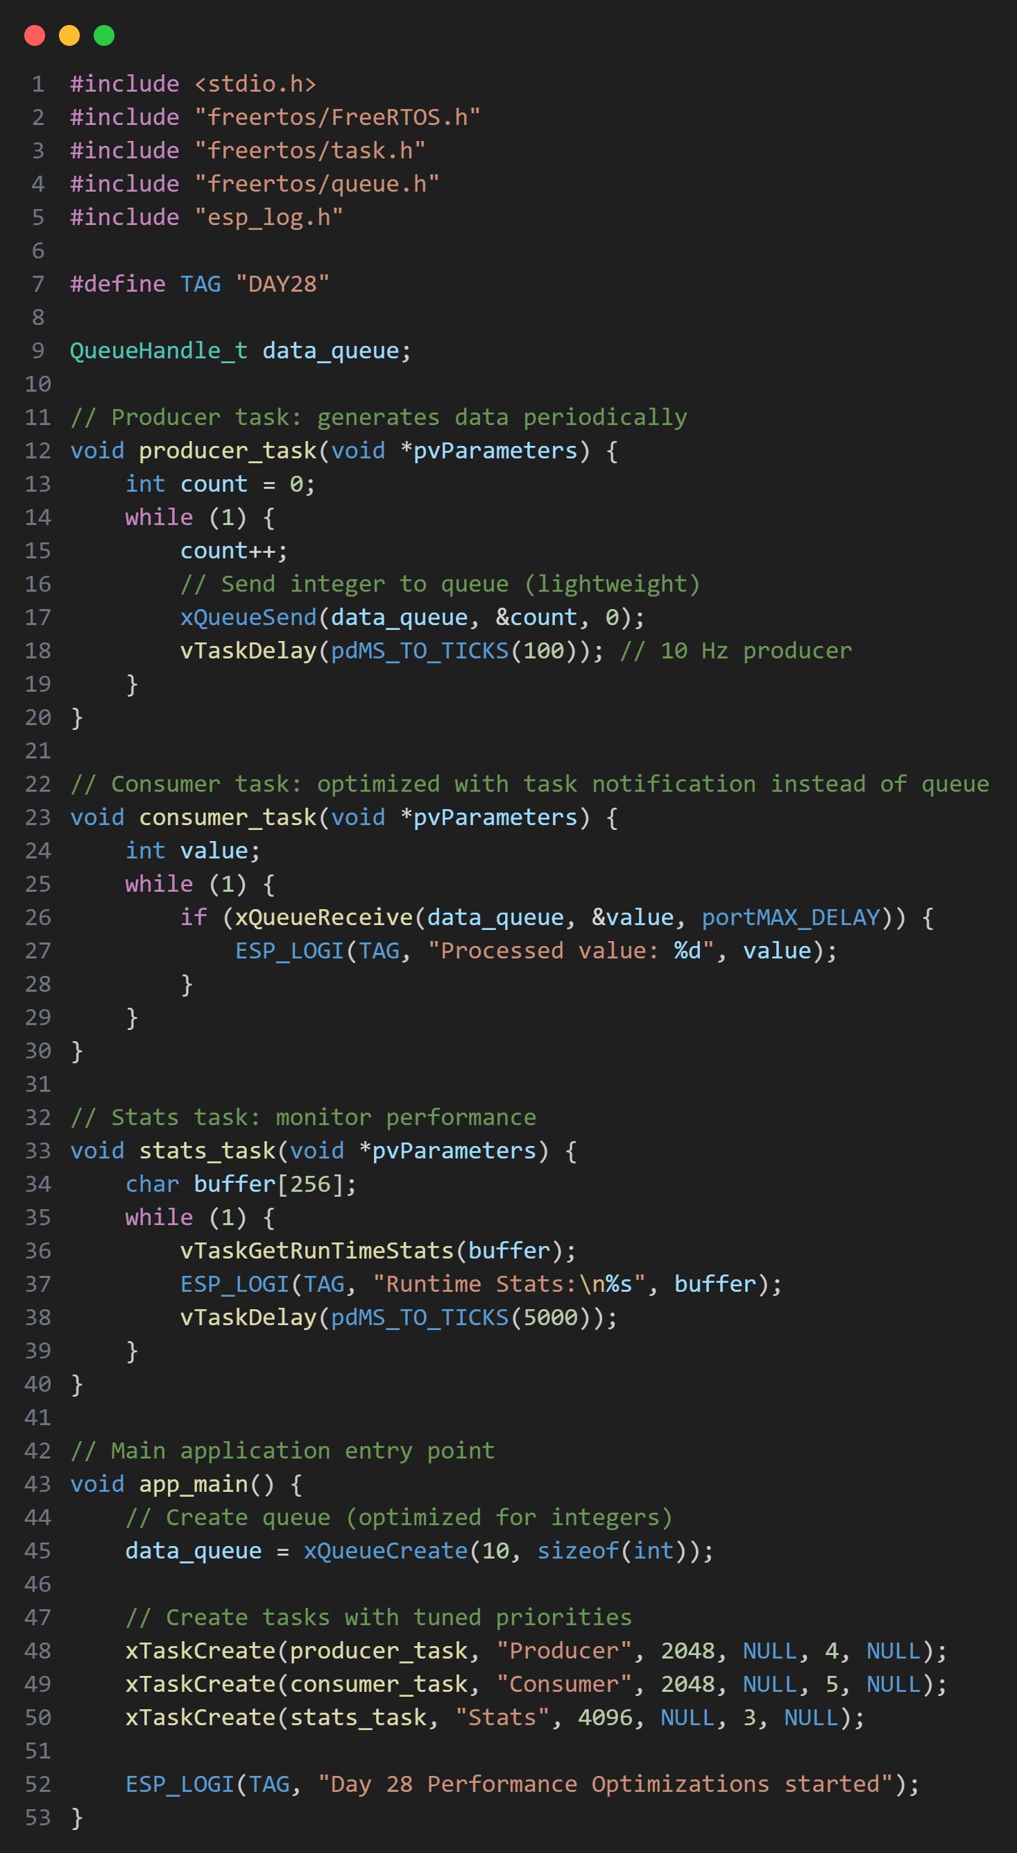
Example – Optimizing Task Performance
This code demonstrates performance optimizations in FreeRTOS tasks.
It includes a producer-consumer model using queues and task notifications,
along with a stats task to monitor performance.
The code is optimized for better CPU and memory usage.
Key optimizations:
Use of task notifications for lightweight signaling.
Efficient queue usage with minimal data size.
Task priority tuning for responsiveness.
Periodic stats collection to monitor performance.
Expected Behavior
Producer sends small, lightweight integers (efficient).
Consumer receives data without blocking overhead.
Stats task logs runtime performance every 5 seconds.
Output:
I (1000) DAY28: Processed value: 10
I (5000) DAY28: Runtime Stats:
Task Time CPU%
Producer 200 4%
Consumer 300 6%
Stats 100 2%

Slide 18
Example – Optimizing Task Performance
This code demonstrates performance optimizations in FreeRTOS tasks.
It includes a producer-consumer model using queues and task notifications,
along with a stats task to monitor performance.
The code is optimized for better CPU and memory usage.
Key optimizations:
Use of task notifications for lightweight signaling.
Efficient queue usage with minimal data size.
Task priority tuning for responsiveness.
Periodic stats collection to monitor performance.
Expected Behavior
Producer sends small, lightweight integers (efficient).
Consumer receives data without blocking overhead.
Stats task logs runtime performance every 5 seconds.
Output:
I (1000) DAY28: Processed value: 10
I (5000) DAY28: Runtime Stats:
Task Time CPU%
Producer 200 4%
Consumer 300 6%
Stats 100 2%

Slide 19
Example – Optimizing Task Performance
This code demonstrates performance optimizations in FreeRTOS tasks.
It includes a producer-consumer model using queues and task notifications,
along with a stats task to monitor performance.
The code is optimized for better CPU and memory usage.
Key optimizations:
Use of task notifications for lightweight signaling.
Efficient queue usage with minimal data size.
Task priority tuning for responsiveness.
Periodic stats collection to monitor performance.
Expected Behavior
Producer sends small, lightweight integers (efficient).
Consumer receives data without blocking overhead.
Stats task logs runtime performance every 5 seconds.
Output:
I (1000) DAY28: Processed value: 10
I (5000) DAY28: Runtime Stats:
Task Time CPU%
Producer 200 4%
Consumer 300 6%
Stats 100 2%

Slide 20
This code demonstrates performance optimizations in FreeRTOS tasks.
It includes a producer-consumer model using queues and task notifications,
along with a stats task to monitor performance.
The code is optimized for better CPU and memory usage.
Key optimizations:
Use of task notifications for lightweight signaling.
Efficient queue usage with minimal data size.
Task priority tuning for responsiveness.
Periodic stats collection to monitor performance.
Expected Behavior
Producer sends small, lightweight integers (efficient).
Consumer receives data without blocking overhead.
Stats task logs runtime performance every 5 seconds.
Output:
I (1000) DAY28: Processed value: 10
I (5000) DAY28: Runtime Stats:
Task Time CPU%
Producer 200 4%
Consumer 300 6%
Stats 100 2%
Best Practices
Example – Optimizing Task Performance

Slide 21
Best Practices

Slide 22
Summary
Best Practices
✅ Use task notifications for ISR-to-task and
one-to-one signaling.
✅ Keep critical tasks short and deterministic.
✅ Tune tick rate (Day 22) carefully — higher
rates = more overhead.
✅ Regularly check stack usage and heap
headroom.
✅ Use trace tools to catch hidden bottlenecks.
✅ Avoid printf in high-frequency tasks (replace
with queue-to-logger).

Slide 23
Summary

Slide 24
Challenge for Today
Summary
Performance optimization ensures predictable, real-time execution.
Optimize task priorities, context switches, and queue usage.
Use task notifications for efficiency.
Profile and measure system behavior with stats and tracing tools.
Efficient design = longer battery life, faster response, higher reliability.

Slide 25
Challenge for Today

Slide 26

Challenge for Today
Extend today’s project by:
Replace the queue with task notifications and compare CPU usage.
Increase the producer frequency (e.g., 1 ms delay) and measure system impact.
Add a logging task with a mutex-protected UART and compare performance with direct ESP_LOGI calls inside tasks.
"Thanks for watching!
If you enjoyed this video, make sure to hit the like button and subscribe to stay updated with my latest content.
Don't forget to check out my other videos for more tips and tutorials on Embedded C, Python, hardware designs, etc. Keep exploring, keep learning, and I’ll see you in the next video!"
https://www.linkedin.com/in/yamil-garcia
https://www.youtube.com/@LearningByTutorials
https://github.com/god233012yamil

Slide 27
"Thanks for watching!
If you enjoyed this video, make sure to hit the like button and subscribe to stay updated with my latest content.
Don't forget to check out my other videos for more tips and tutorials on Embedded C, Python, hardware designs, etc. Keep exploring, keep learning, and I’ll see you in the next video!"
https://www.linkedin.com/in/yamil-garcia
https://www.youtube.com/@LearningByTutorials
https://github.com/god233012yamil

